Slide 1

Salary Book
Manage Business Details, Employees details, Salary Details In Just Few Clicks

Slide 2

Description
To keep and manipulate the details of all employees in business.
To keep record of employee’s details and employee’s attendance details.
To keep and manipulate the details of all business.
To keep record of business’s details.
To help small business to grow their business using this system.
This system is provided free to use for business owner.

Slide 3

Objective
To help Small Business to grow their Business using Salary Book.
To help Small Business Like Kirana Store , Construction Site workers etc.
To grow their Business Using Our Simple Web App Salary Book.
To Help small business to grow theirs own’s hand

Slide 4

Technologies & Tools
HTML , CSS ,JAVA SCRIPT , BOOT STRAP → For Development of front end part
DJANGO → For backend part
MONGO DB → For Storing data
VS CODE → Using This Software We develop This Web App.

Slide 5
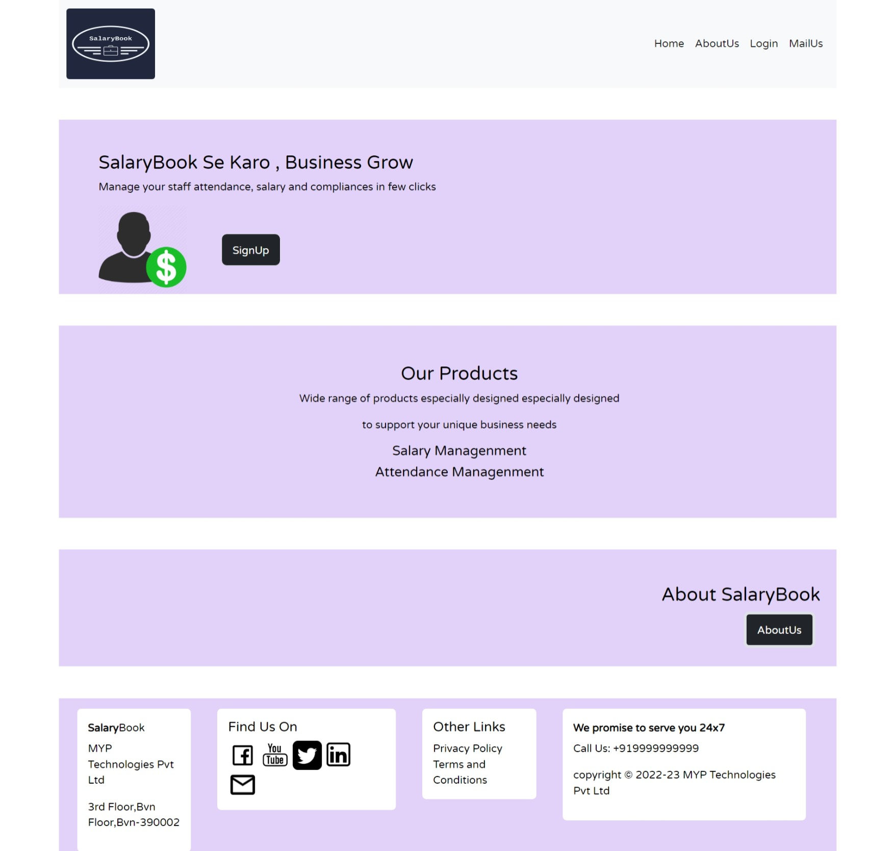
Home Page
This is Home Page of Salary Book .
This is Basic Home Page of Salary Book.
And There is many link to Redirect Another Page.

Slide 6
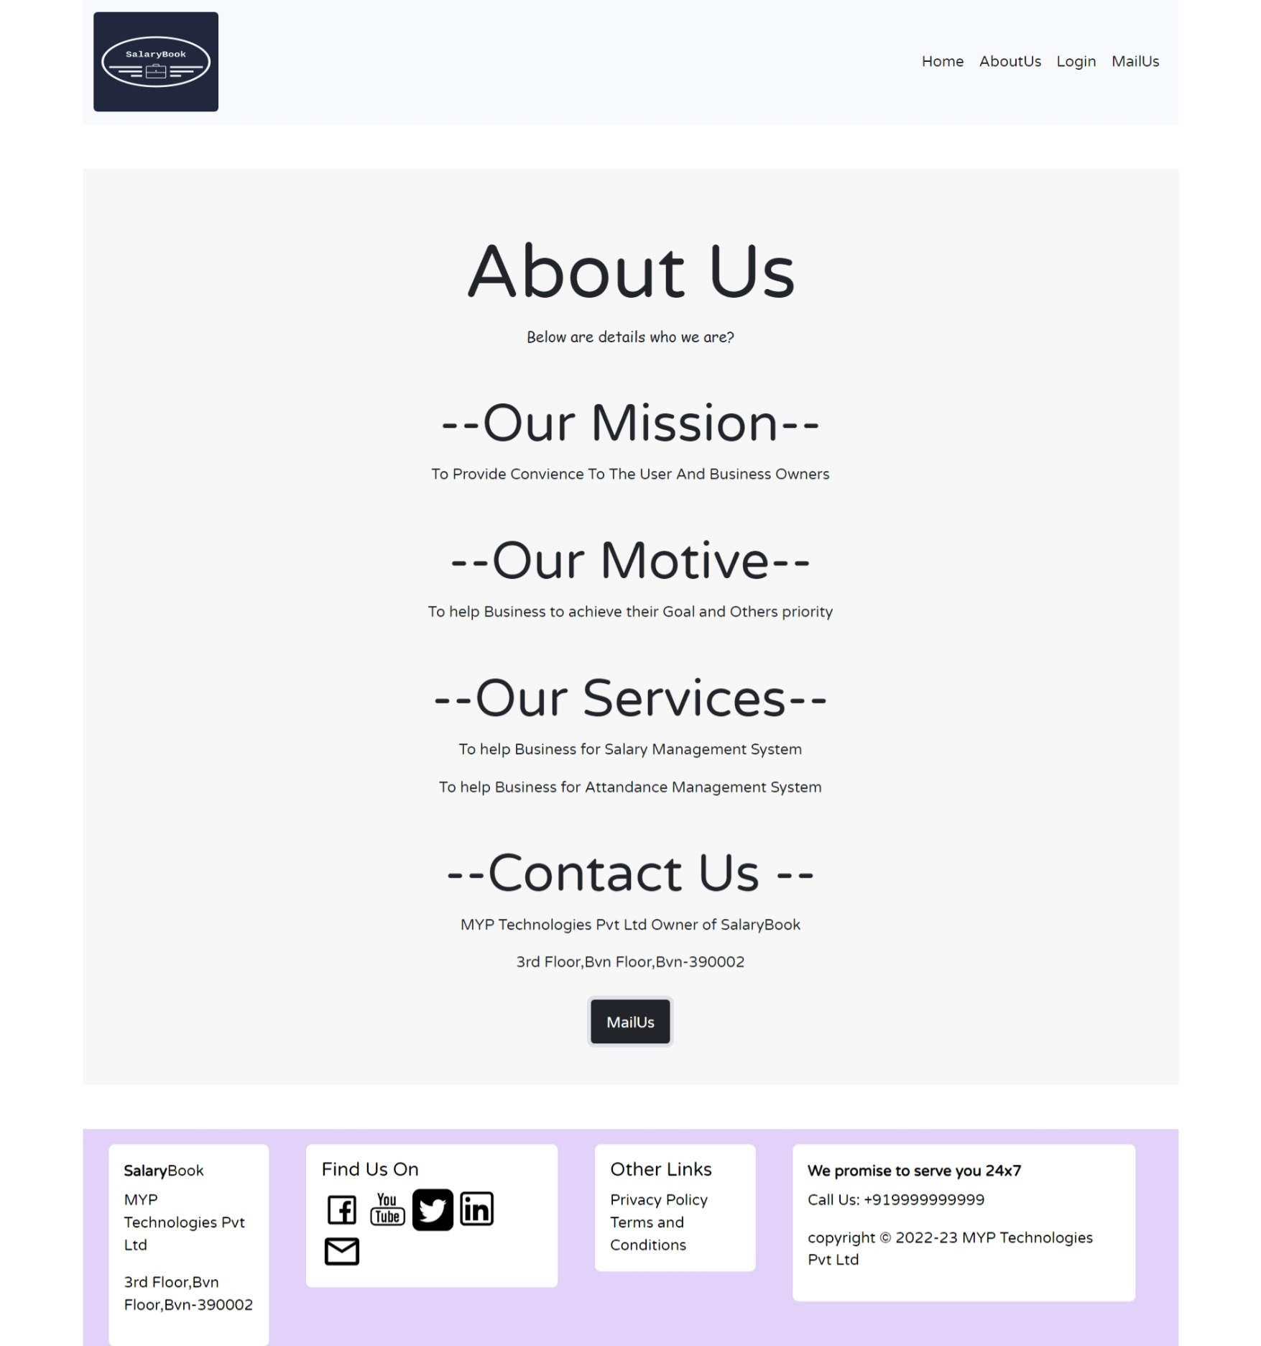
About Us Page
This is about page of Salary book .
That page Shows about our mission,
our Motive, our Services etc.

Slide 7
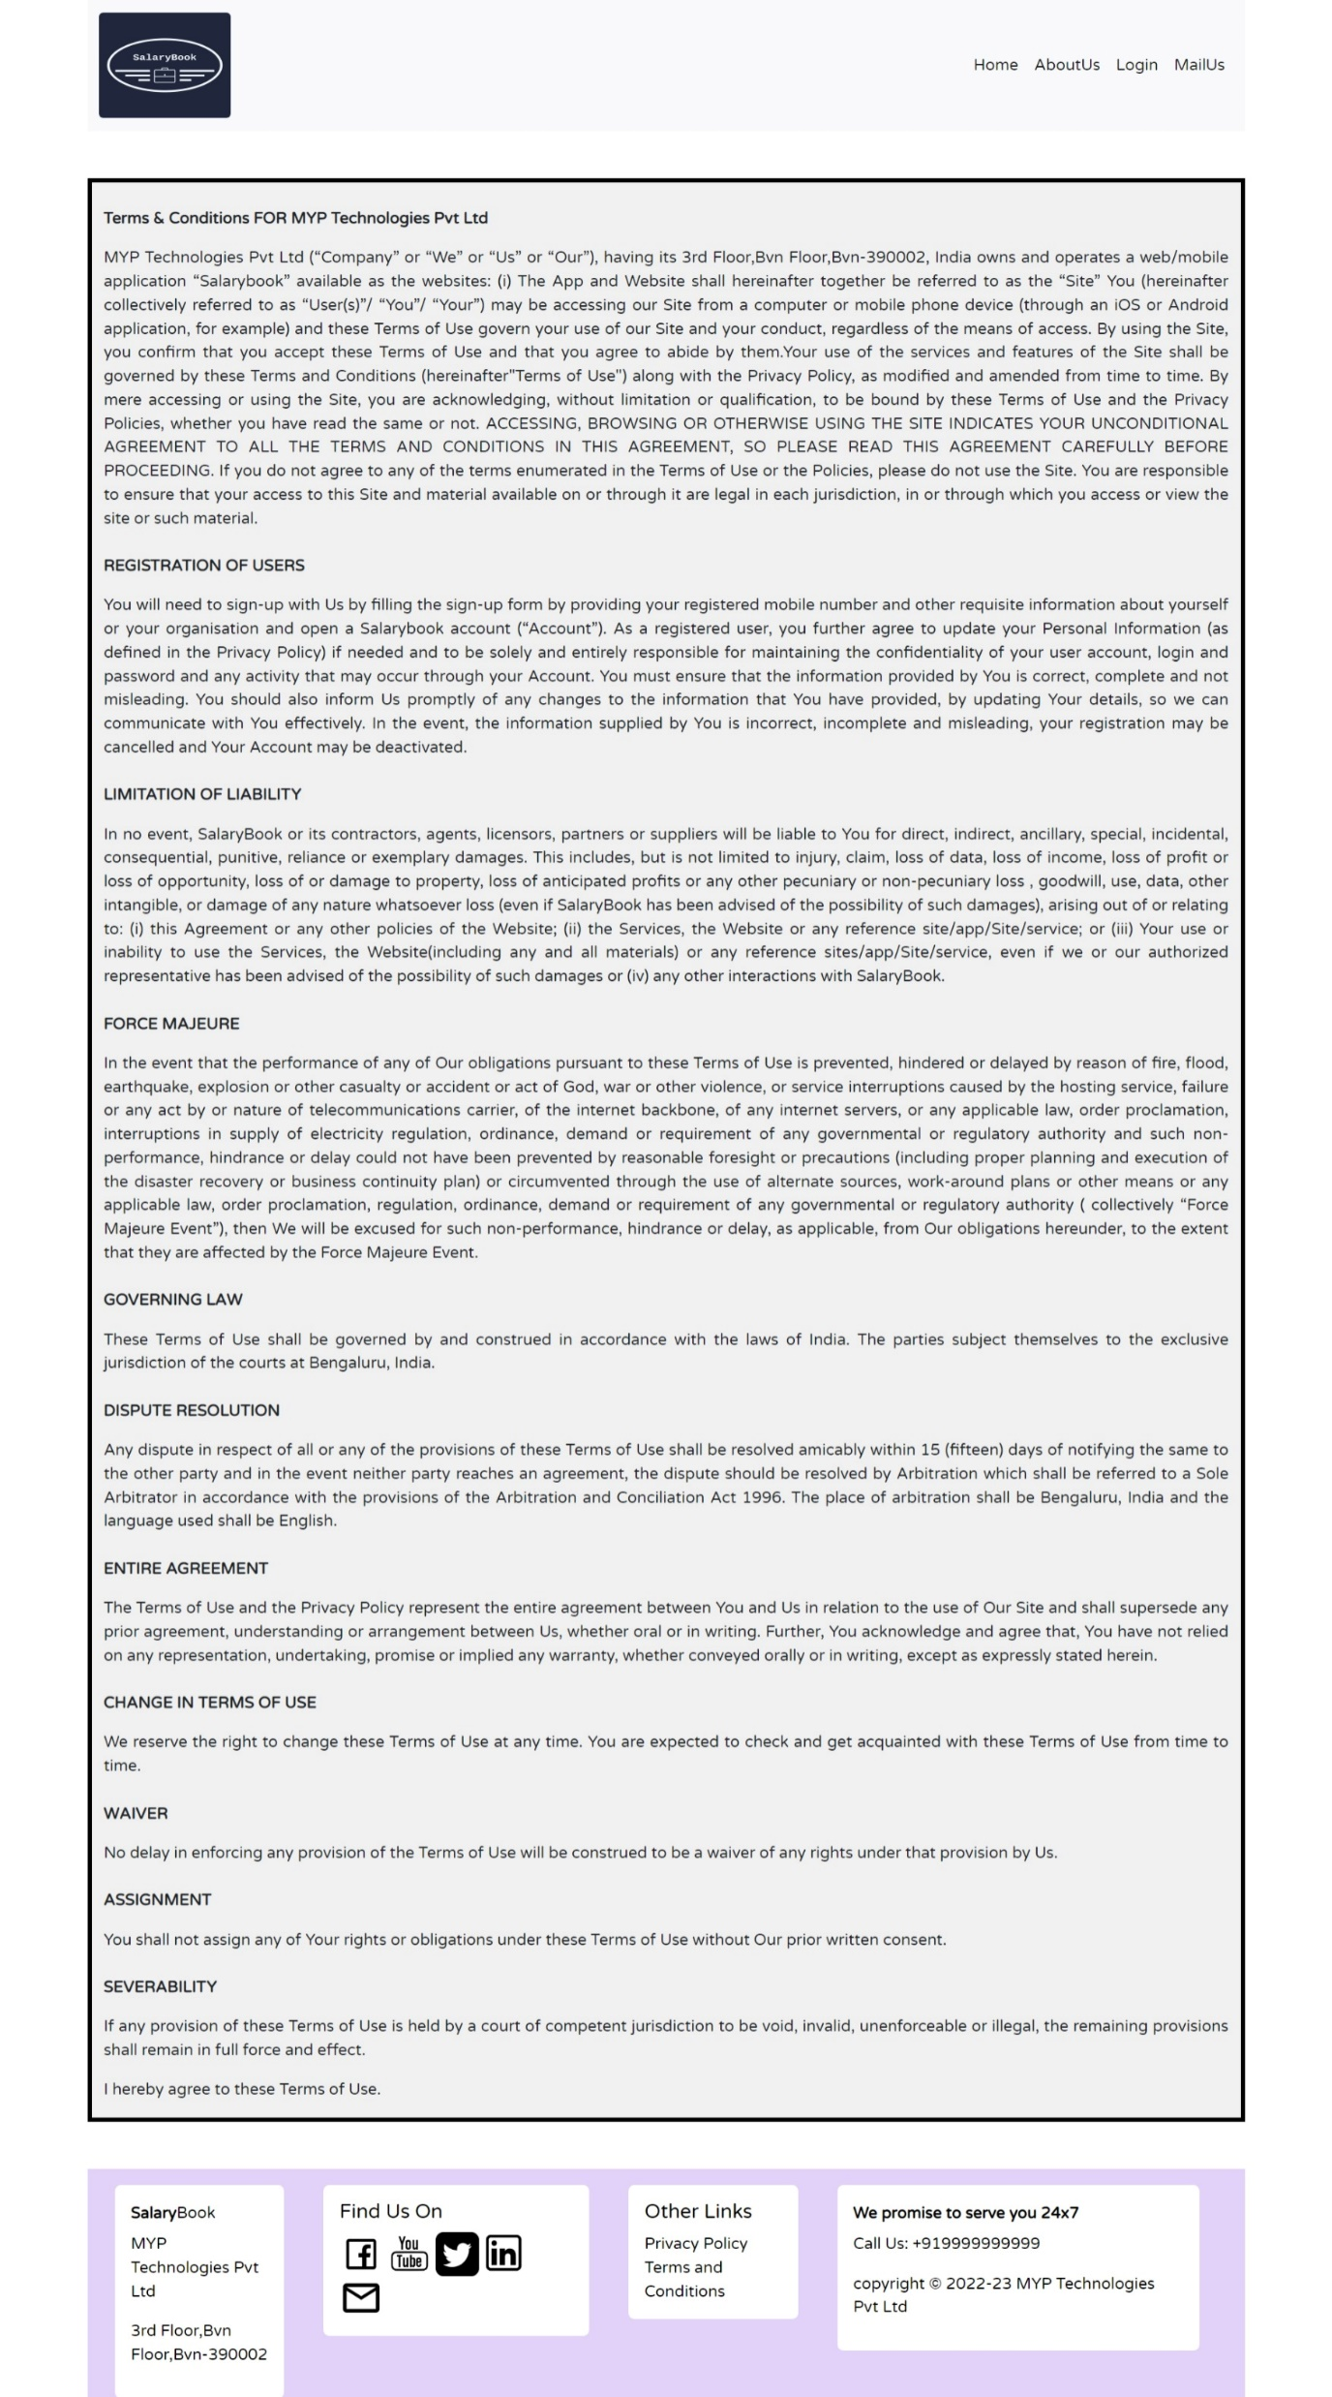
Terms And Conditions Page
This is Term and Conditions Page about Salary Book.
There is conditions about to use Salary Book web App.

Slide 8
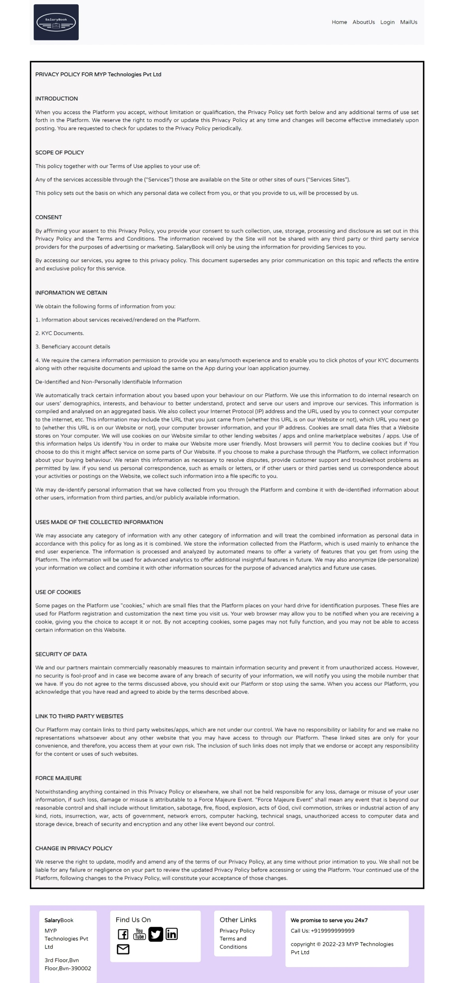
Privacy Policy Page
That page shows about Privacy Policy Of Salary book.

Slide 9
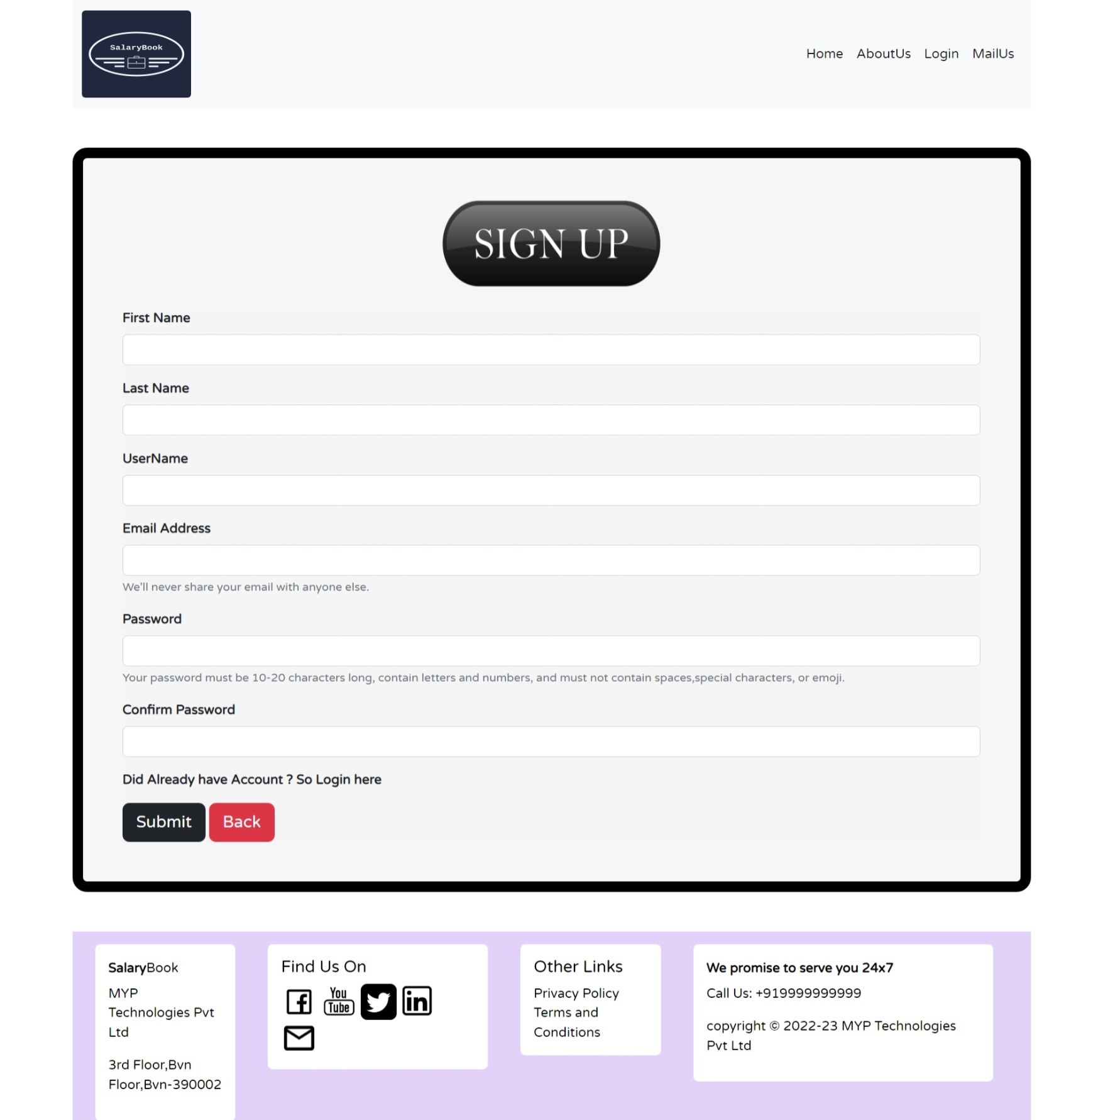
Sign Up page
First User register to our web applications with field
is first name ,last name, username, Email address,
password and confirm password field.
All fields are required .
So all the fields required and fill that fields carefully.
After signup page user will redirect to the login page.

Slide 10
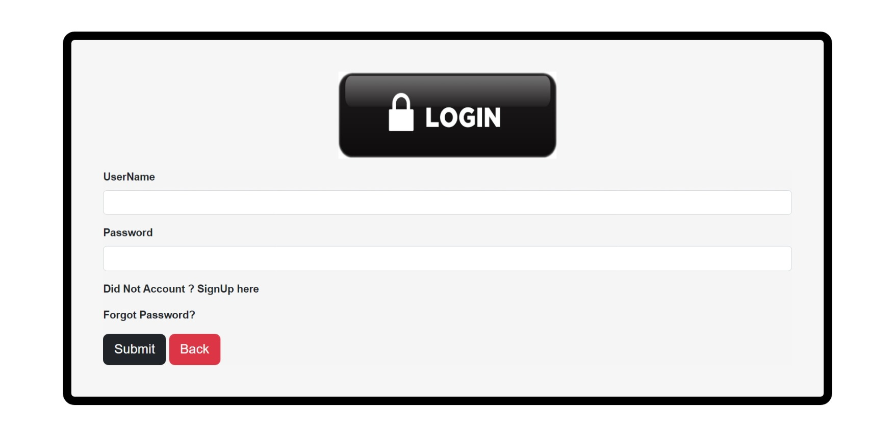
Login page
That page is login page of Salary Book web applications.
There is username and password field for using Salary Book
Web Applications. If user has no username and password
then user first register the Salary Book Web Applications .
If user forgot their password then user will be able to
change their password using forgot password facility
with mail system.

Slide 11
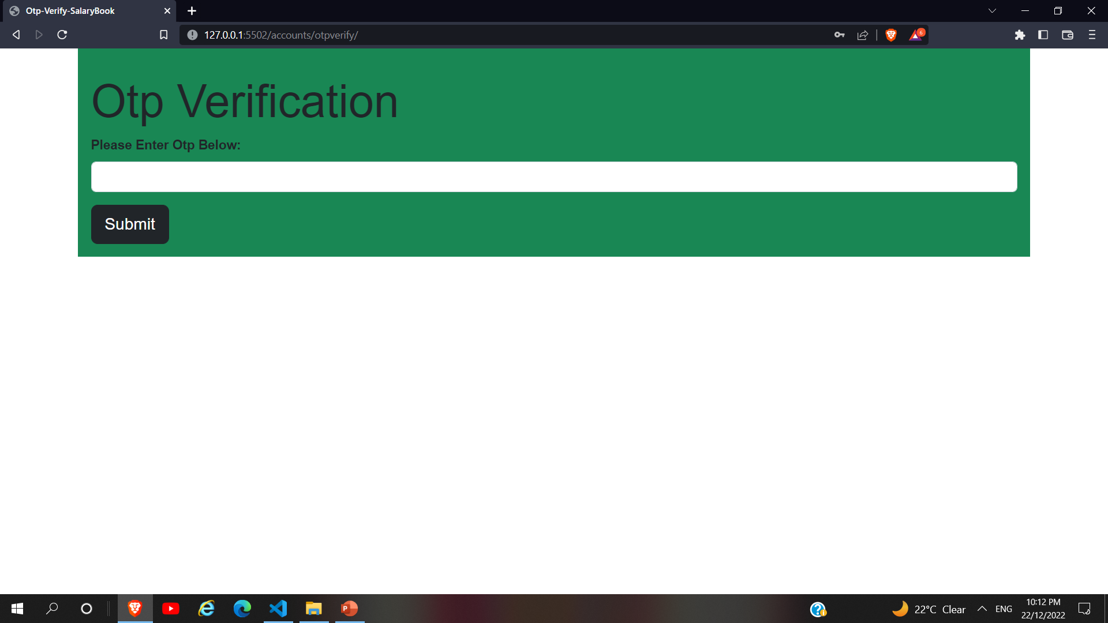
Otp Verify page
That page is otp verify page of Salary Book web application.
There is the otp is send to the registered mail id. Otp is 8 digit.
Enter the otp in the otp field. Then After you redirect the Dash
Board Page.

Slide 12
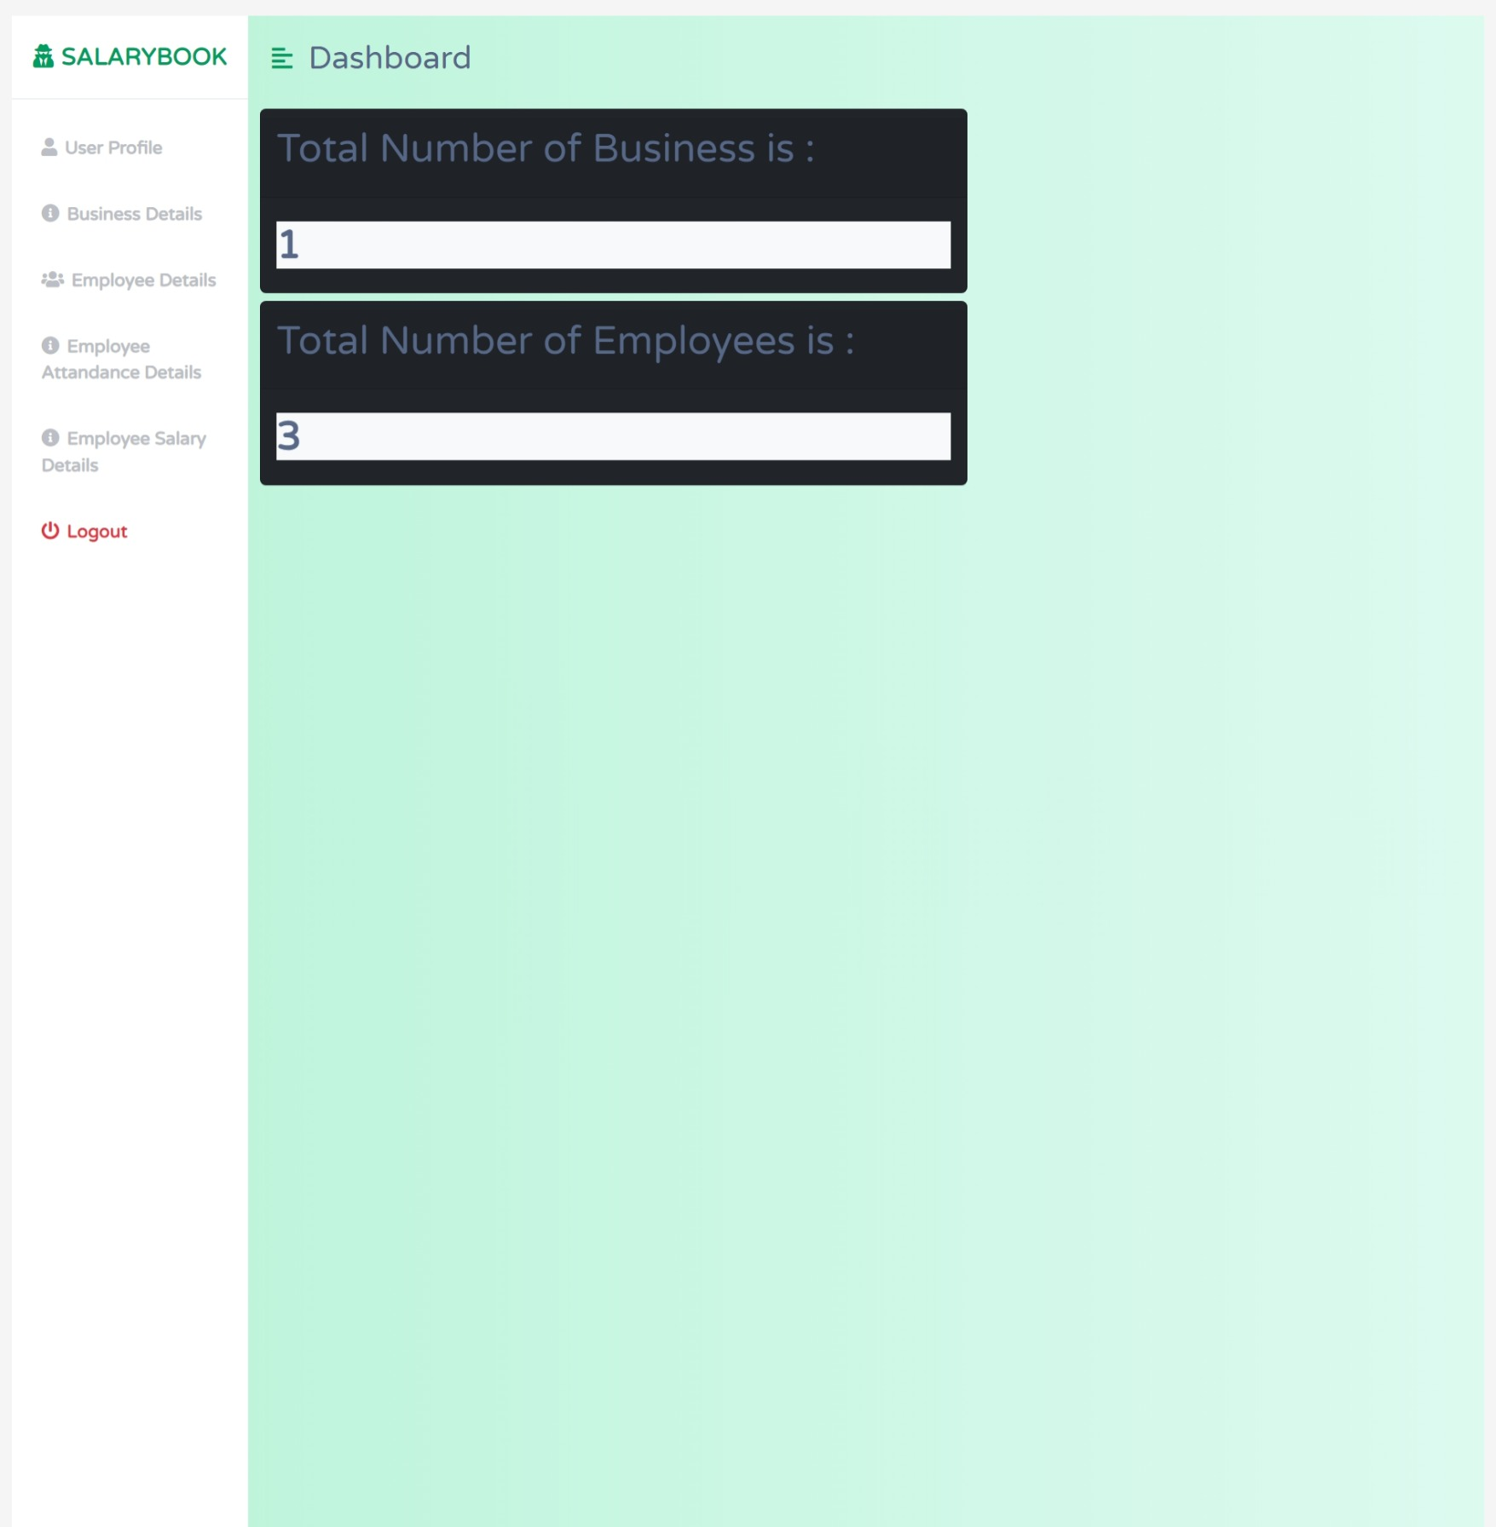
Dashboard Page
After successfully login user will redirect to the
dashboard page and user is manage all the
details show as above. In dashboard page user
will see total number of business and total
numbers of employees.

Slide 13
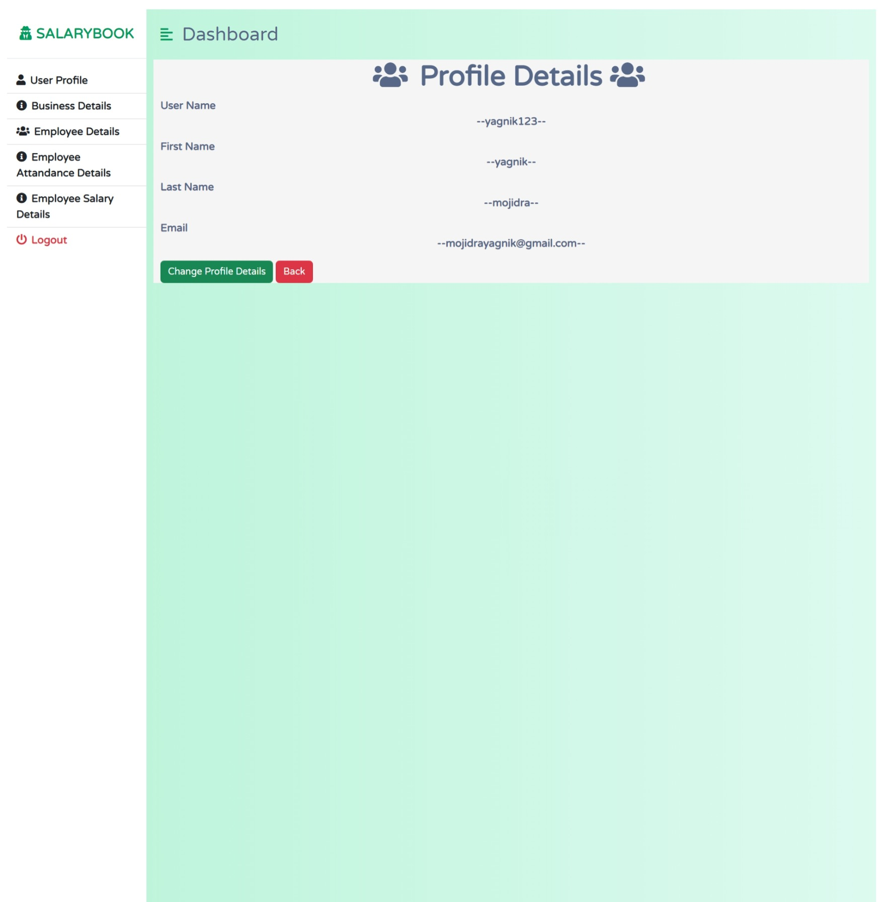
Profile Page
When user is click profile detail section user
see their profile details. In this page user is
change user profile using change profile
details button. When user is click that button
that time open the change profile form and
user is able to change their profile page.
That page is about of user profile .

Slide 14
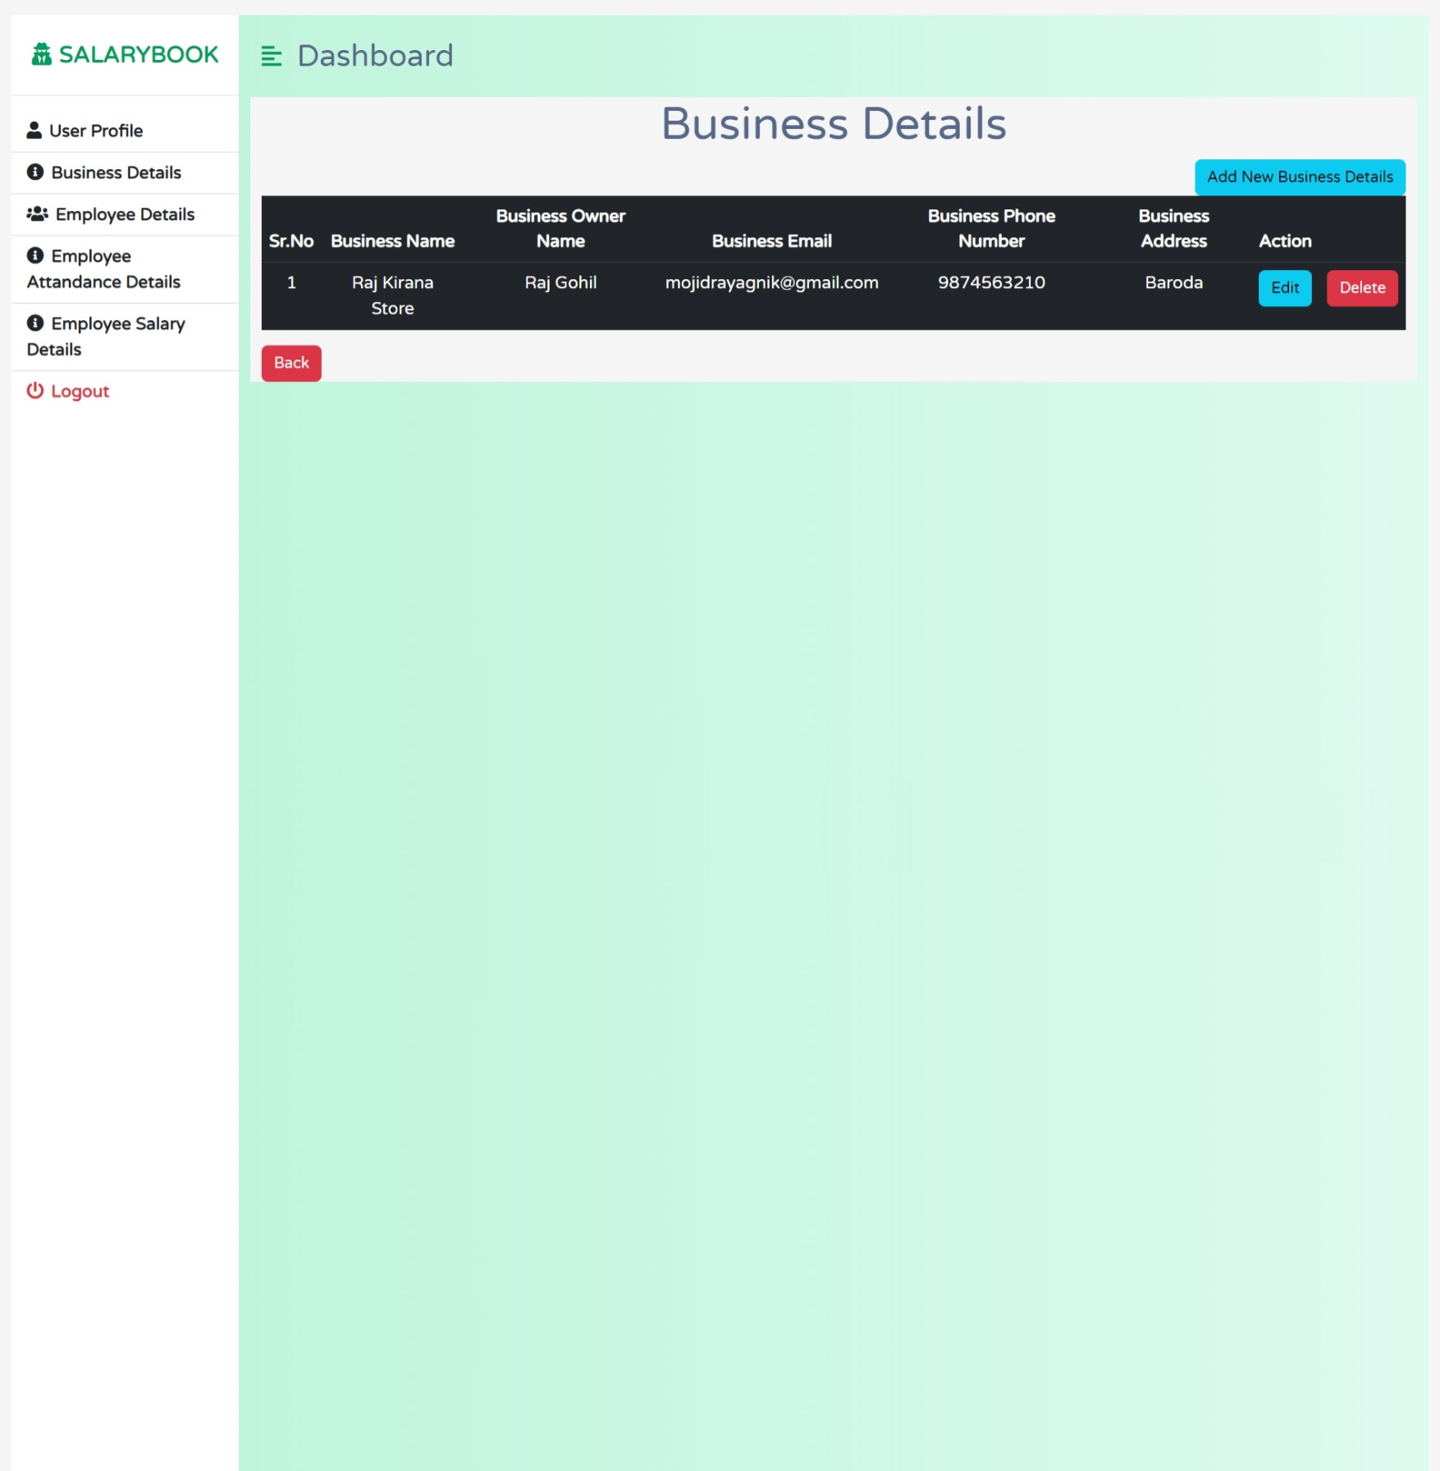
Business Details Page
That page is about to Business details page.
There is option has Add new Business details,
Edit and Delete Button .When User is Click on
the Add new business Details Button at a time
add business details page is open add user will
be able to add their business details. When user
is click on the edit button at a time a edit business
details page is open and user is able to edit their
business details. When user is click on the delete
that time that records will be deleted.

Slide 15
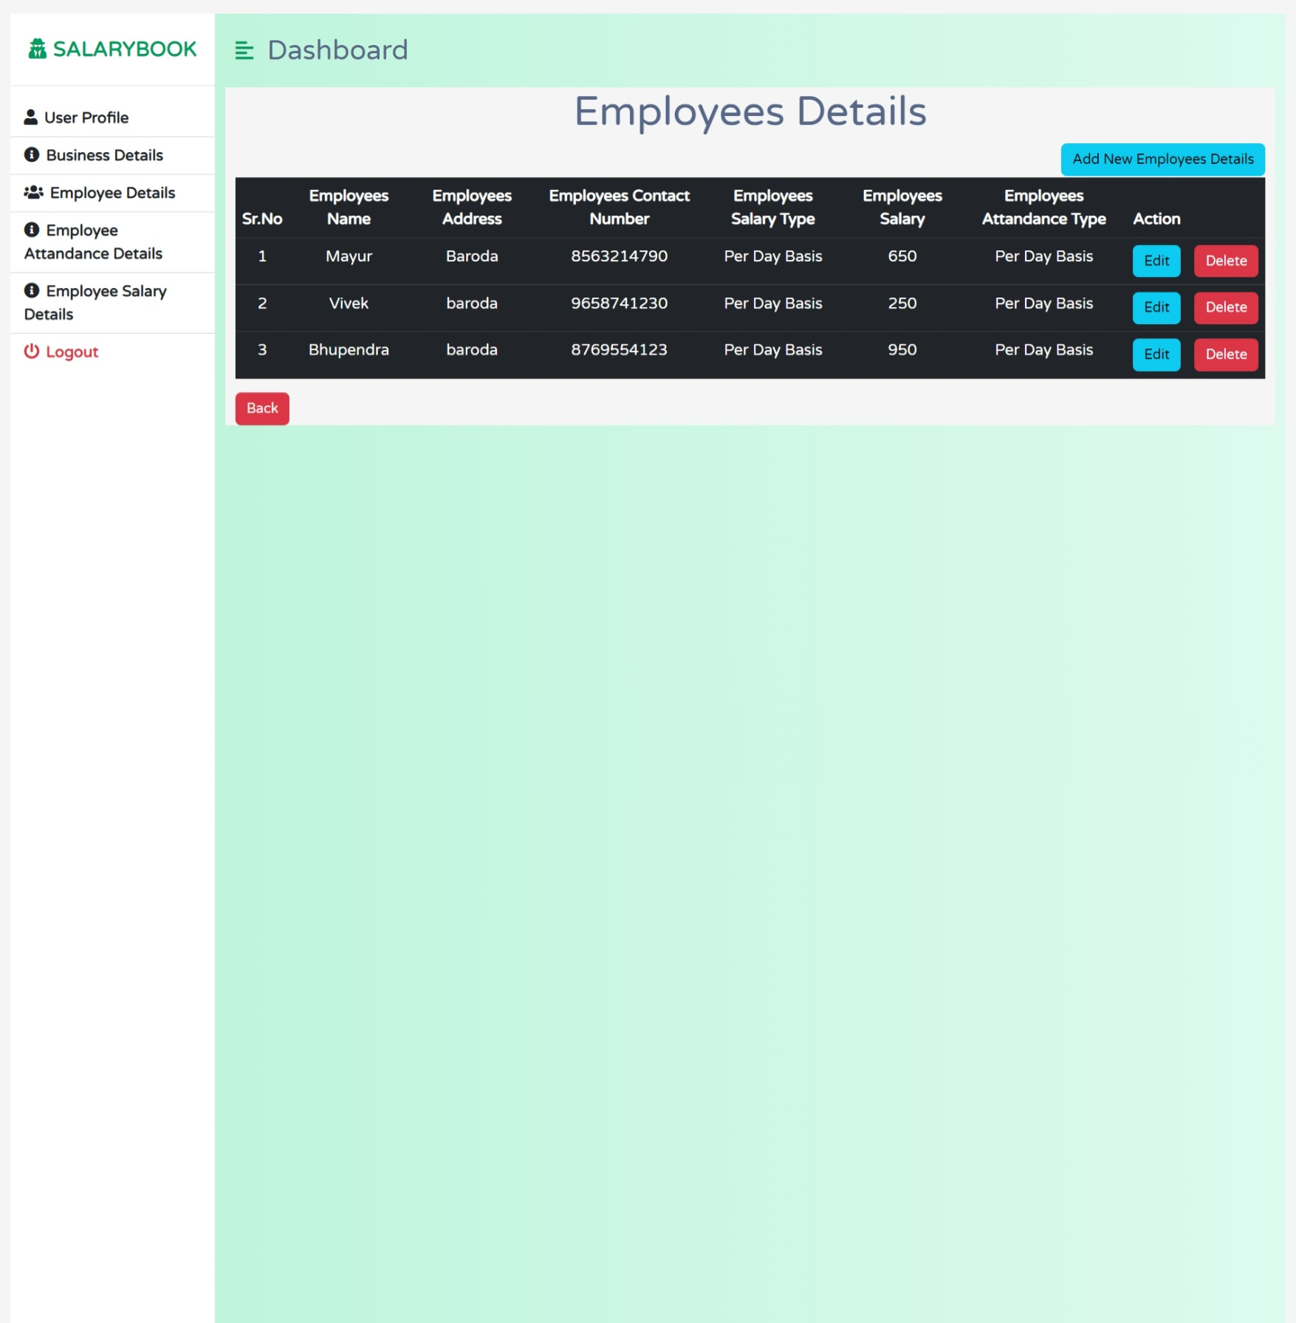
Employees Details Page
That page is about to Employees details page.
There is option has Add new Employees details,
Edit and Delete Button .When User is Click on
the Add new Employees Details Button at a time
add Employees details page is open add user will
be able to add their Employees details. When user
is click on the edit button at a time a edit Employees
details page is open and user is able to edit their
Employees details. When user is click on the delete
that time that records will be deleted.

Slide 16
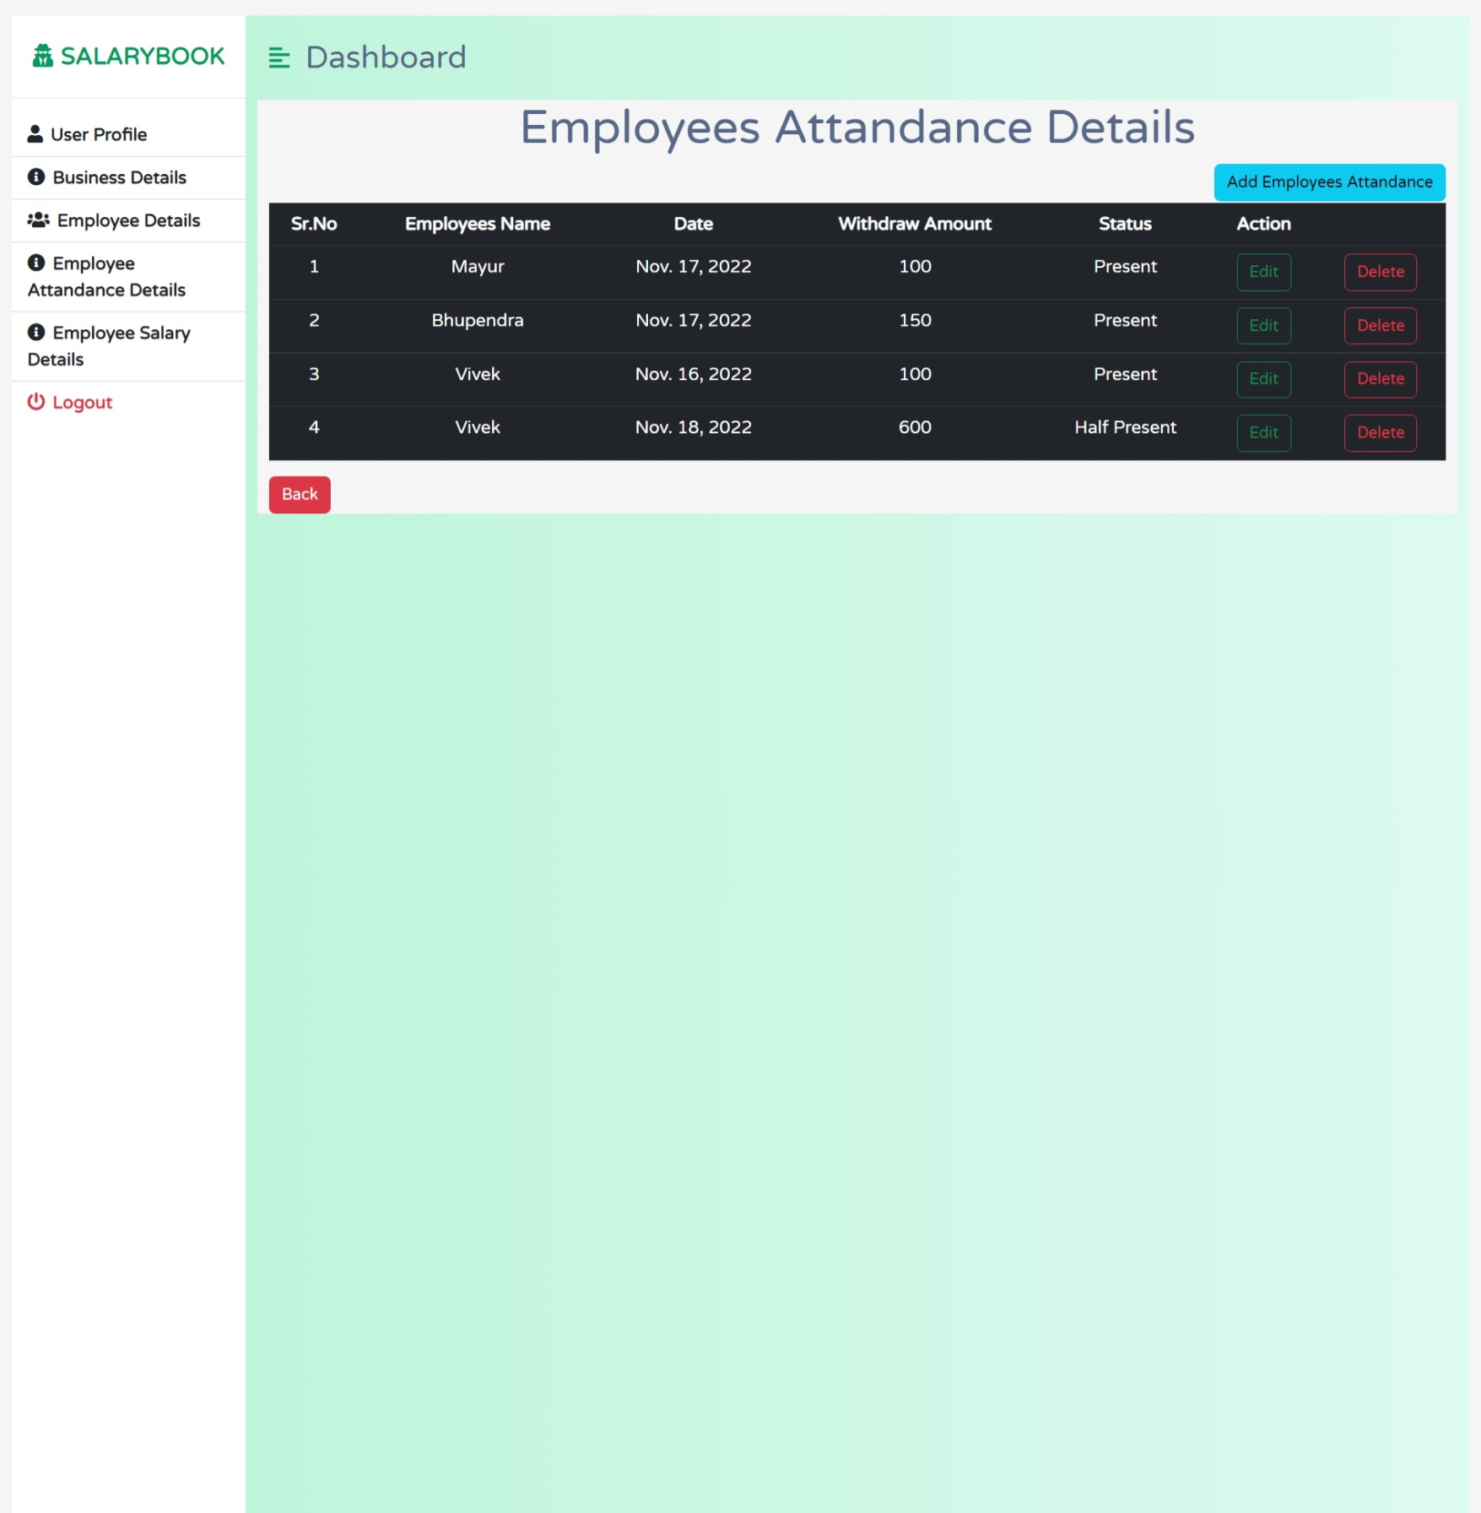
Employees Attendance Page
That page is about to Employees Attendance Details page.
There is option has Add new Employees Attendance details,
Edit and Delete Button .When User is Click on the Add new
Employees Attendance Details Button at a time add
Employees Attendance details page is open add user
will be able to add their Employees Attendance details.
When user is click on the edit button at a time a edit Employees
Attendance details page is open and user is able to edit their
Employees Attendance details. When user is click on the delete
that time that records will be deleted.

Slide 17
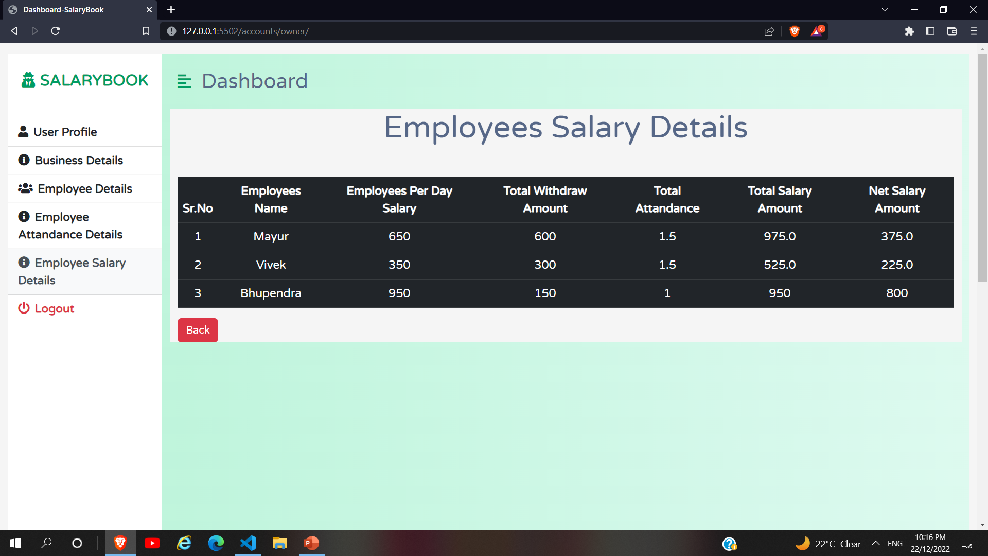
Employees Salary Page
That page is about to Employees Salary Details page.
There is only views options then user only shows
employees salary details.

Slide 18

About Us
Group No : 11
Mojidra Yagnik Prakash bhai
Prn : 2019033800126574
Email : mojidrayagnik@gmail.com
Mentor: Mr. Sunny Kamra

Slide 19
Thank You

